Slide 1
Introduction to Psychology
Thinking like a scientist – Case study
Sumitava Mukherjee

Slide 2
Studying real world phenomena: LAY IDEA TO BASIC RESEARCH
Think or Sleep on it
Lay intuition
Scientific Psychology
Operationalize
Hypothesize
Measure
Analyze
Conclude
2

Slide 3
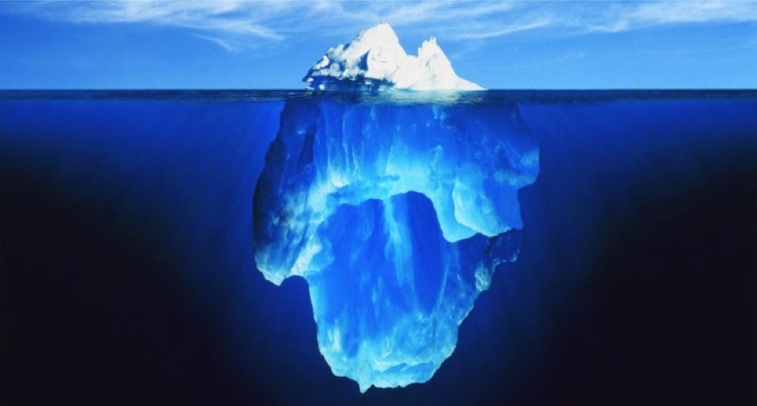
A common picture
Let the unconscious guide one’s decisions

Slide 4
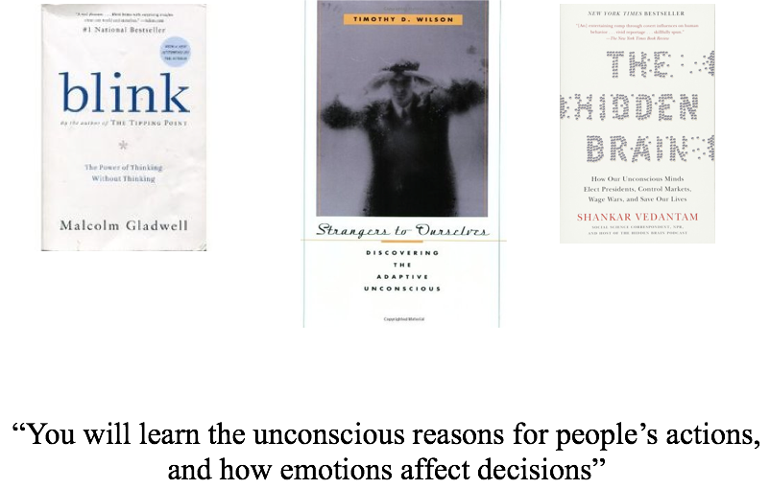
A large collection of books

Slide 5
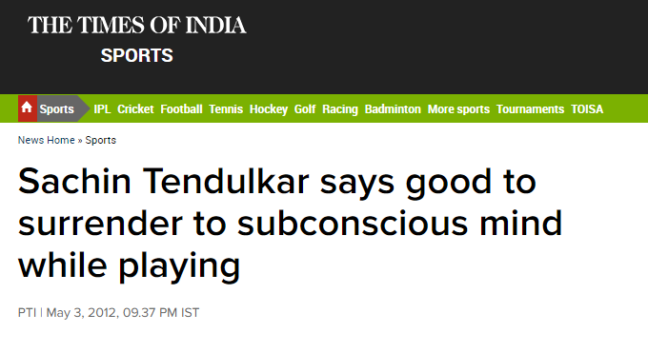
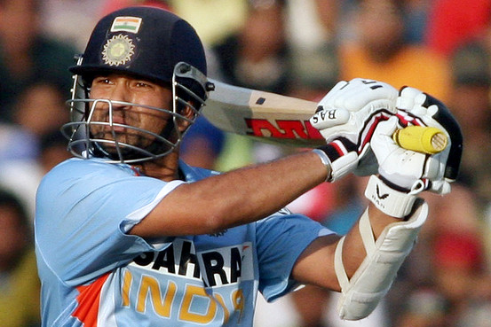
What is unconscious thought?
“The conscious mind can sometimes create problems,"

Slide 6
What is unconscious thought?
Attempts to operationalize and delineate
Beyond/Below the “thinking” mind (Freud?)
Not conscious (not being aware, not attend to)
Not thinking actively (but sleep over)
Not thinking actively (and nothing else)

Slide 7
Key questions
How to define unconscious thought?
How to measure quality of choice?
What are the information processing mechanisms?
Where are the influences?
How do we know it is ‘unconscious’?
Is the ‘unconscious’ superior?
Is it Reliable? Relevant?

Slide 8
Operational attempt
“Conscious thought is defined as ‘object- relevant’ or task-relevant cognitive or affective thought processes that occur while the object or task is the focus of one’s unconscious attention, while unconscious thought simply occurs when the object or task is outside of attention” (Dijksterhuis & Nordgren, 2006).
ASSUMPTIONS OF UNCNSCIOUS THOUGHT THEORY
“Unconscious cognition is just not suitable for simple feats, but the unconscious is powerful, without capacity limitations, which uses a bottom-up processing style, appropriately weights the relative importance for attributes in decision, engages in associative processing and divergent thinking.”

Slide 9
How to measure quality of choice?
Procedure:
Information presentation stage (3 min)
Distraction stage (3 mins)
Judgment/Decision stage (no limit)
Quality is based on how many follow a normative rule (e.g., weighted-additive or Tally)
Satisfaction (post-choice rating)

Slide 10

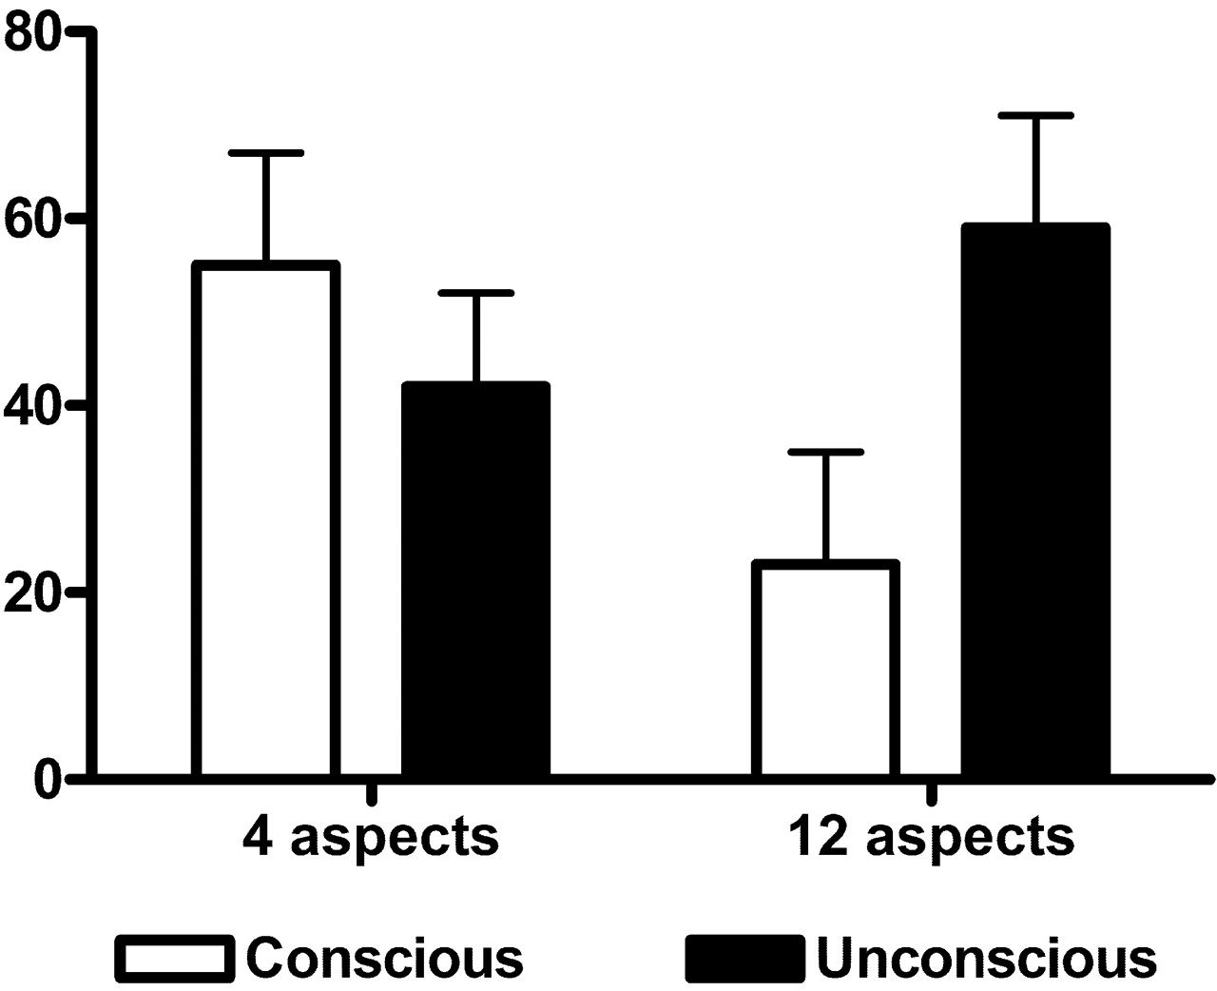
Claimed merits of unconscious thought (UT)
“On making the right choice”
– Dijksterhuis et al. 2006
Dijksterhuis, A., Bos, M. W., Nordgren, L. F., & Van Baaren, R. B. (2006).
On making the right choice: The deliberation-without-attention effect. Science, 311(5763), 1005-1007.

Slide 11
And, we, the critics arrived: [1] Operationalization
“Deliberation-without-attention” = distraction
What if attention is itself manipulated?

Slide 12
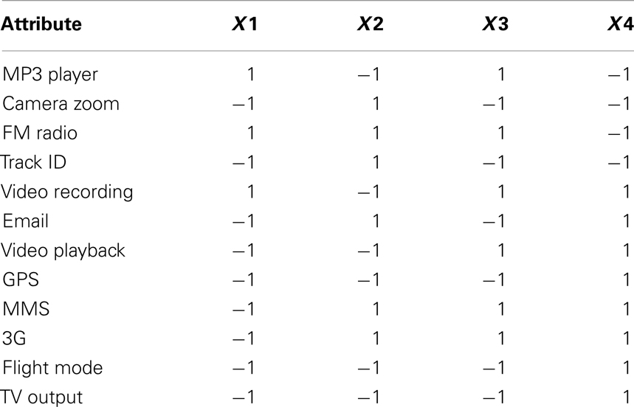
Choice problem

Slide 13
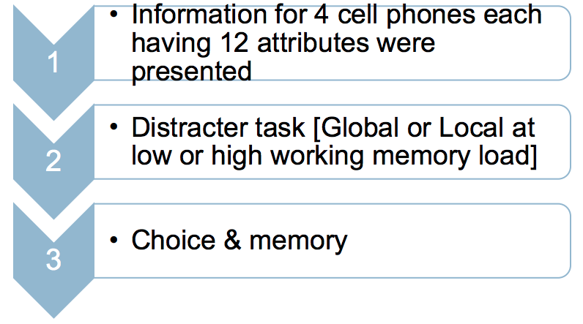
Perceptual scope of attention during UT
(Srinivasan, Mukherjee, Kesarwani, Mishra, 2013)

Slide 14
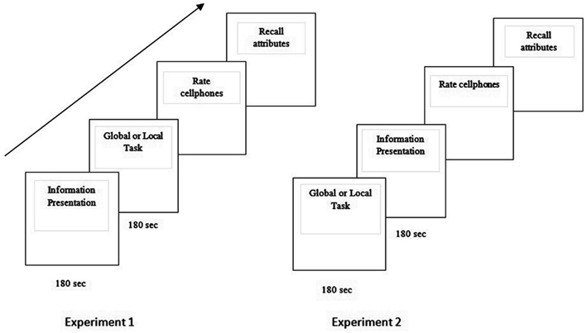

Slide 15
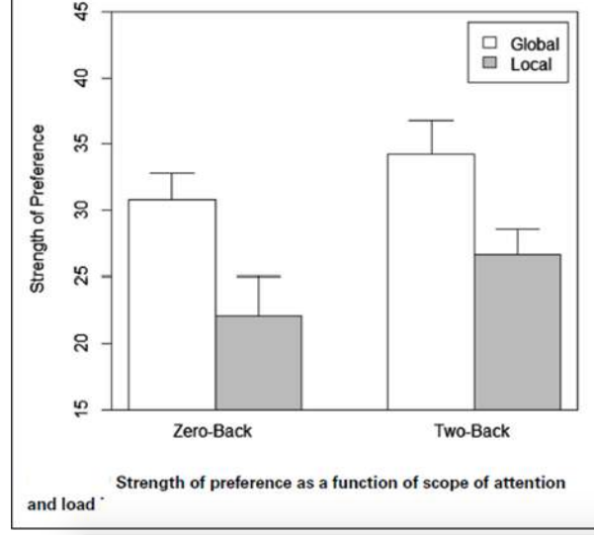
Perceptual scope of attention during “UNCONSCIOUS THOUGHT”

Slide 16
So, operationalization is problematic
Unconscious thought cannot be “without attention”
The thinking during distraction is crucial (but why should it be)

Slide 17
And, we, the critics arrived: [2] Cue integration / Weighting
Claims of unlimited capacity is difficult to test
How much information needs to be processed?
How is information selected (mechanisms)?

Slide 18
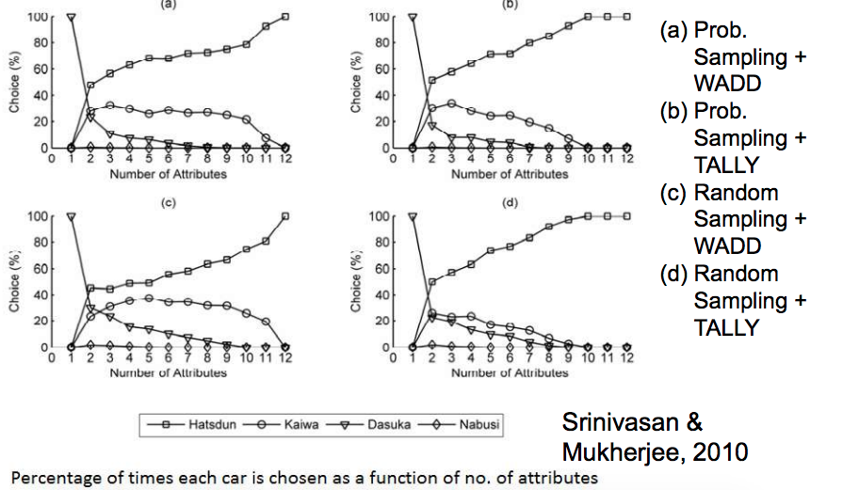
Computer simulations - Cars

Slide 19
Comparison of behavioral results and computation simulations
Cars
Study 1
Study2
Study3
SIM (3)
SIM(4)
Hatsdun
58
43
63
56
63
Kaiwa
-
27
23
23
29
Dasuka
-
27
3
10
7
Nabusi
25
3
10
10
1
Percentage of choices for each car
From Srinivasan & Mukherjee, 2010

Slide 20
So, the assumptions of UTT are problematic
There is no need to posit unlimited processing – Sub-sampling works fine
In reality, UT does not consider all/most attributes
There is no need to posit comprehensive weighting
Probability-based sampling works well

Slide 21
Sum up
PSYCHOLOGICAL SCIENCE NEEDS TO BE SOLID, TESTABLE, REPLICABLE, INFORMATIVE, CONSISTENT.
TERMS SHOULD BE WELL DEFINED (OPERATIONALIZED)
MEASURES SHOULD BE WELL DEFINED, TESTABLE, OPEN DATA (HOPEFULLY)
BOUNDARIES AND CONSTRAINTS TO BE DEFINED OR DISCOVERED
THEORY AND DATA NEEDS TO CROSS-TALK
APPLY THE FINDING TO YEILD INSIGHTS – LINK BASIC TO APPLIED DOMAINS
21

